Slide 1
Mobile Programming Subject: Chronometer / Stop Watch
Mert karaca
201818016
Computer programmıng 2nd class

Slide 2
What is Chronometer Object ?
In a stop watch / chronometer application , we use «chronometer» object to make our workflow easy.
Beside handler and runnable based chronometer applications, we can hold and show minute,second,milisecond seperately and write our code more clear and readable.

Slide 3
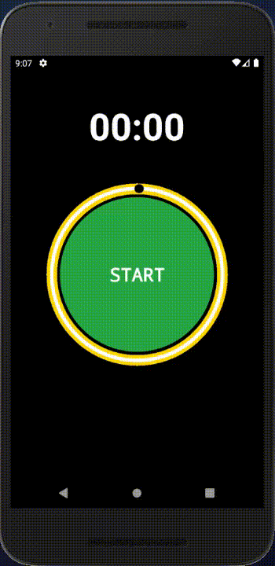
To be more spesific, it work like this;

Slide 4
Let’s start doing our example !
First we open an empty Project(Empty Activity) and create our .xml files.
In this way, we will not have to deal with layouts anymore. We just focus on our code to make .xml files work
All layouts are available under App > Res > Layout. Right-click here from the Project section and click on New > «Layout resouce file» and name the layout.

Slide 5
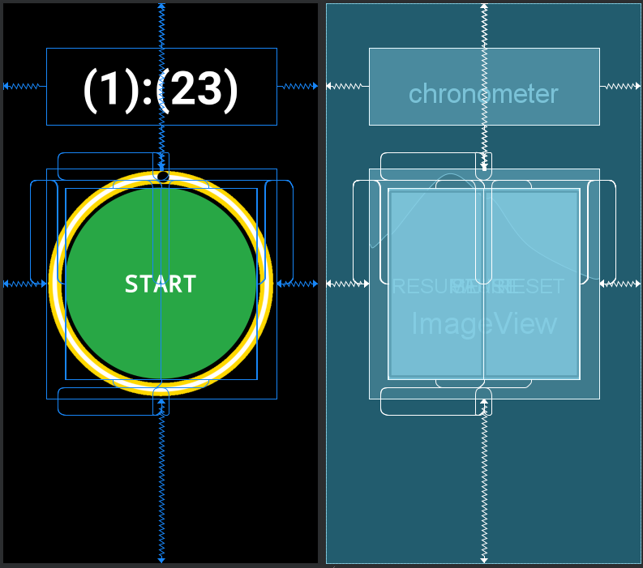
Design: Activity_main.xml

Slide 6
Designing the UI
Chronometer object is easy to use in java files. But since we want a nice UI design, we'll deal with XML files a bit.
Don’t worry ! There is nothing to fear. We’ll have fun at the end !
Our activity_main.xml start like this. But we want different design lines in our UI.

Slide 7
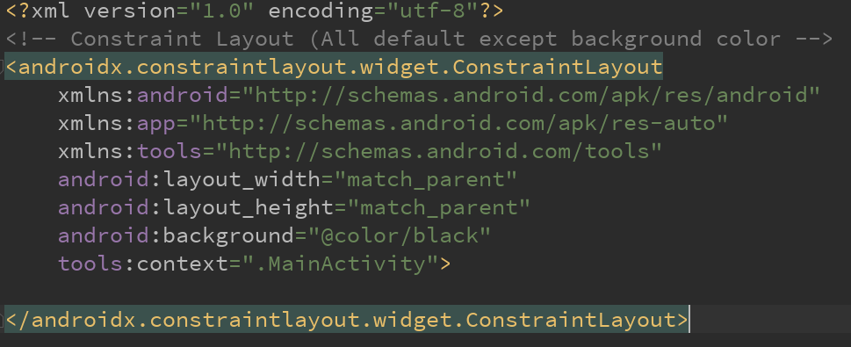
Text: Activity_main.xml

Slide 8
Designing the UI
We put here a black color instead of default one. Let’s check our color file. We can access it with the following path;
App > Res > Values > colors.xml
We can add 16M color and give different names to each one. As we see now;

Slide 9
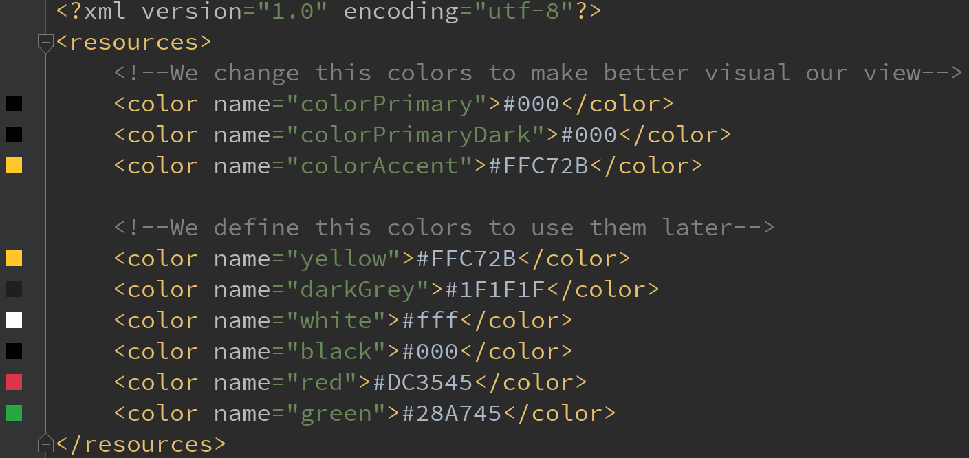
Text: colors.xml

Slide 10
Designing the UI
Let’s return to our activity_main.xml file.
We start to design our UI with chronometer. It will be the backbone of this application.
To be clear we need to remember this again, we don’t have to mess with xml that much but we want our UI look delicious.

Slide 11
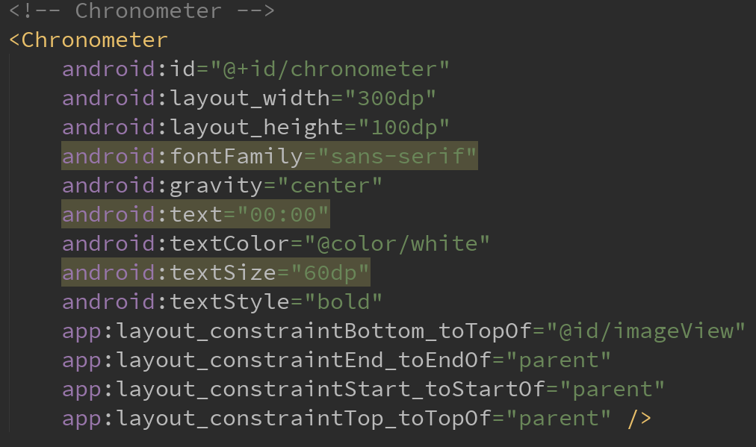
Text: Activity_main.xml

Slide 12
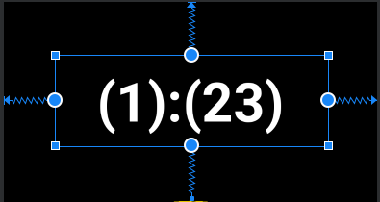
Design: Activity_main.xml

Slide 13
Designing the UI
We designed our chronometer object. We know that if we don’t change anything, the parent of all objects in layout is layout.
Before we forward the design, we need to adjust the prerequistes.

Slide 14
Designing the UI
We need to add our image files to use them in xml files.
To make this we need to add our images in the following path;
App > Res > Drawable
If you don’t have circle.png and ic_main.png don’t worry.
I already added this files too in Github !

Slide 15
Designing the UI
Now we can add our ImageView to our layout.
We using circle image for this. Actually i drawed this in paint.net. If you want different color or design, you may go with your own way !

Slide 16
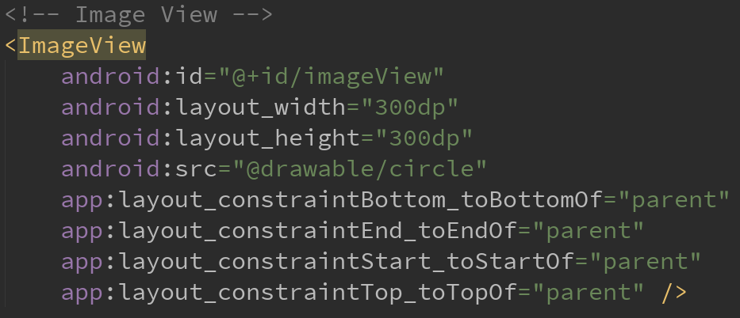
Text: Activity_main.xml

Slide 17
Designing the UI
Now we start to create our buttons. We have four buttons in this application. Start,Pause,Resume and Reset. We want to add this four button as circle and half circle in the middle of the imageView. So before we create the buttons we have to make little drawings on the Drawable file again.
But this time we want to draw something with xml file. To do this;
App > Res > drawable > right click and New > Drawable resouce file
We name this file as circle_button.xml

Slide 18
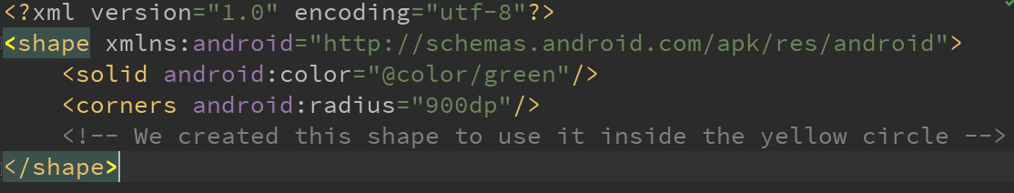

Text & Design: circle_button.xml
It draws an image like this =>
So our buttons will be look more user friendly.

Slide 19
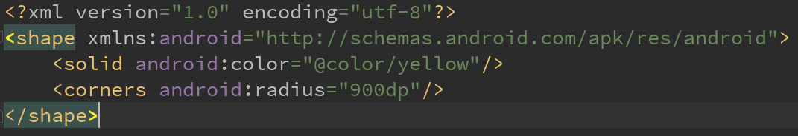

Text & Design: circle_button_yellow.xml
It draws an image like this =>

Slide 20
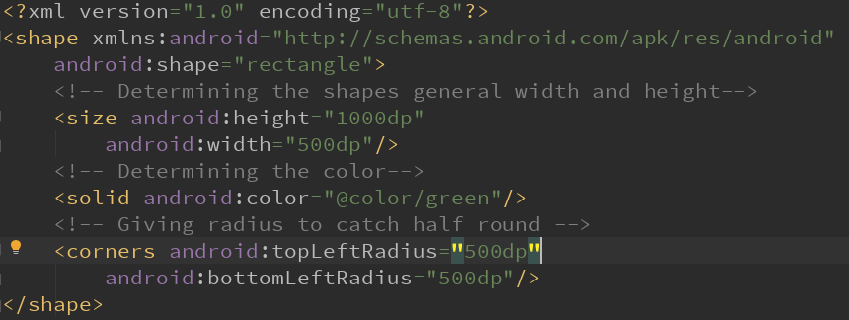

Text & Design: circle_button_green.xml
It draws an image like this =>

Slide 21
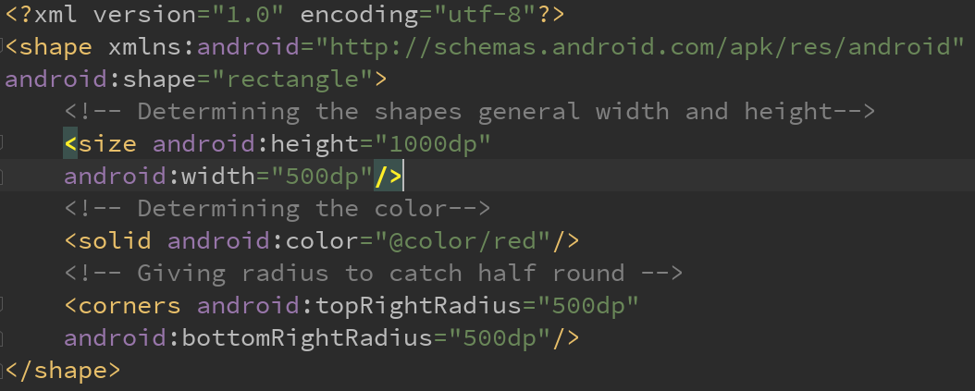

Text & Design: circle_button_red.xml
It draws an image like this =>

Slide 22
Designing the UI
Now we can add our buttons in activity_main.xml file.
As we said before; we have four buttons which Start,Pause,Resume and Reset.
We want to see Start button on activity start. So we set Start button as visible and set invisible the rest, which we see in the next images;

Slide 23
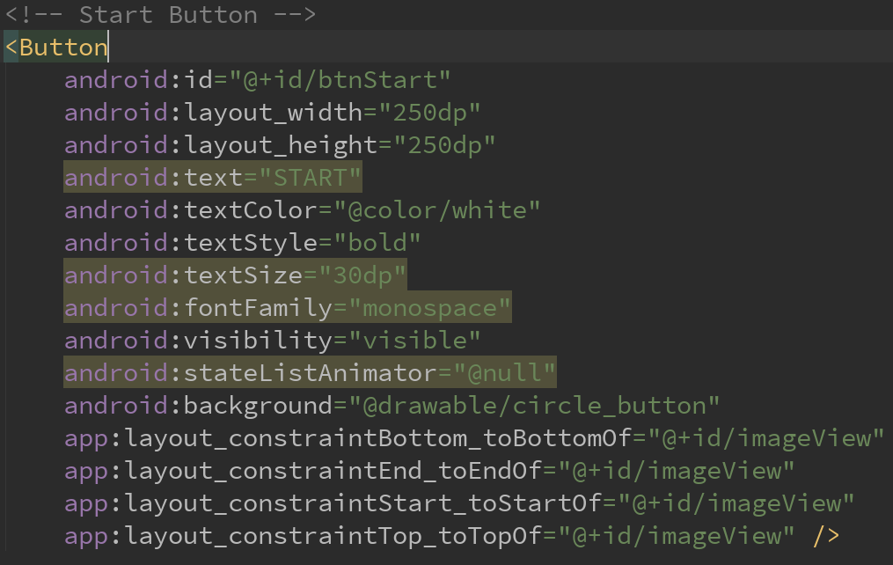
Text: Activity_main.xml – Start Button

Slide 24
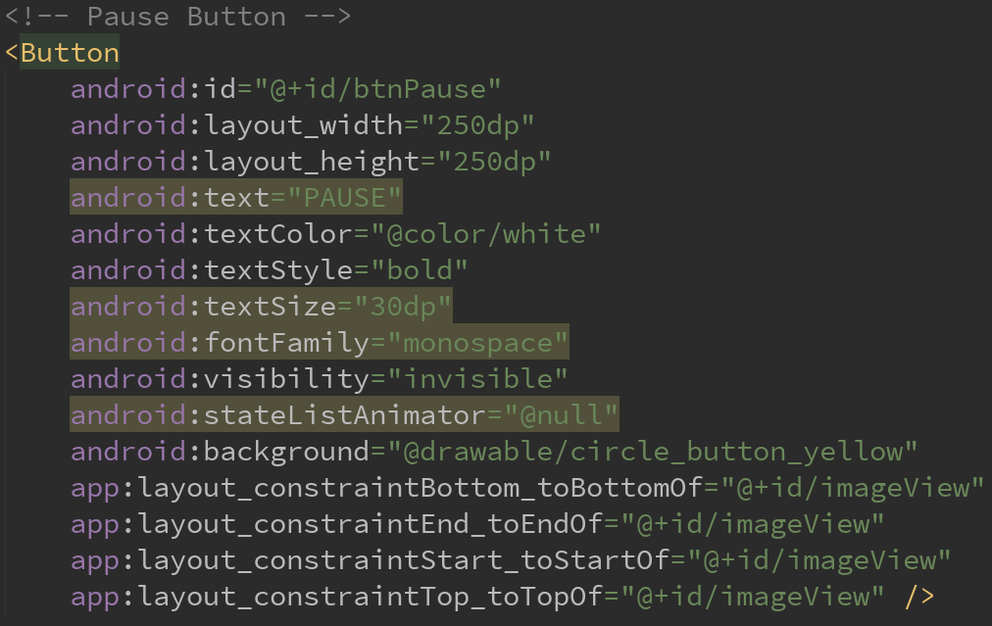
Text: Activity_main.xml – Pause Button

Slide 25
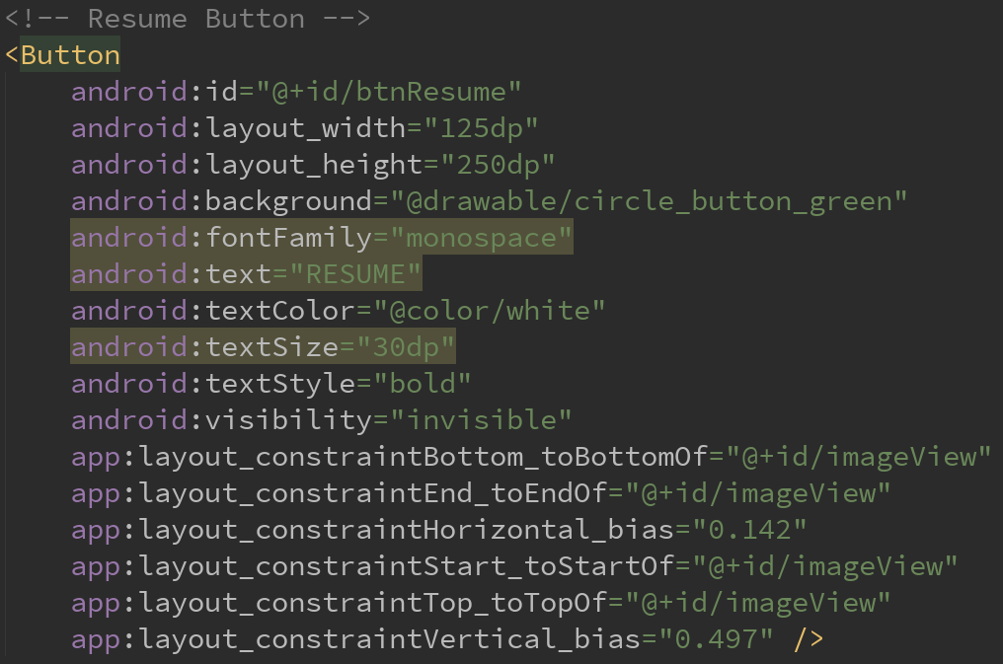
Text: Activity_main.xml – Resume Button

Slide 26
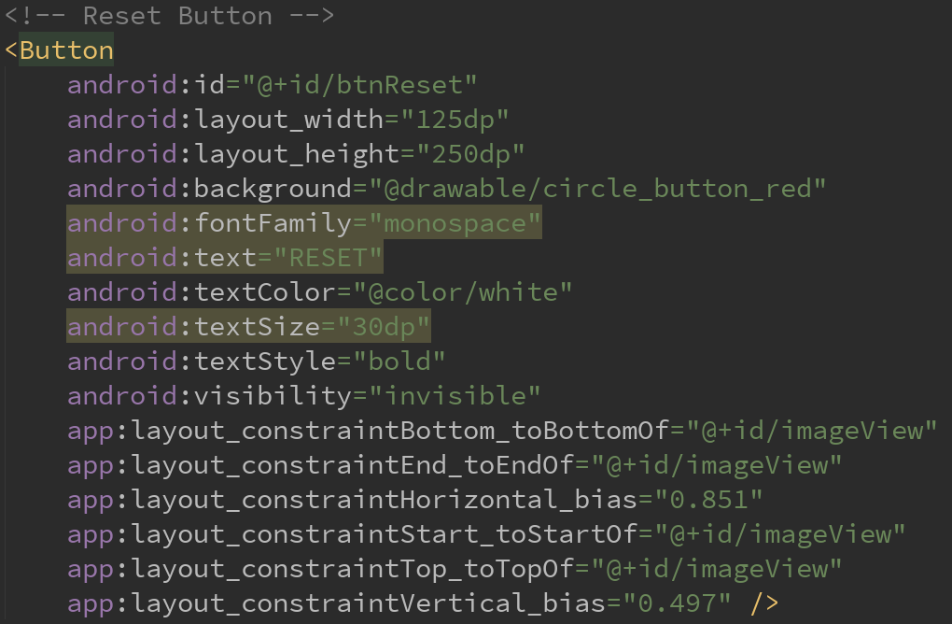
Text: Activity_main.xml – Reset Button

Slide 27
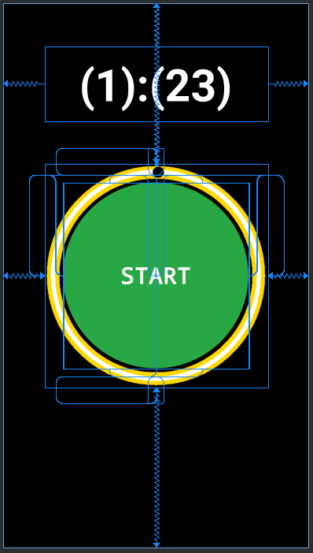
Design: Activity_main.xml’s last state

Slide 28
Designing the UI
Our design section almost finished. Before we start to write our java codes, we want to animate the circle’s black dot in dedicated interval.
There is infinite way to do this. However we use less primitive technique to make this. We will turn the whole circle image, so it will be look like just the black hole at the 12 turning.

Slide 29
Designing the UI
To animate something in the Android, we use animations. Now we will create an anim file in the path below;
App > Res > Anim
After that, to create an animation file we right click the Anim file and select New > Animation resource file
The next two .xml files will be created like this. Before we create rotation.xml we need to create linear_interpolator.xml file to use it in rotation.xml. It’ may be sounds confusing but don’t worry, it’s not !

Slide 30
Text: linear_interpolator.xml
As you can see, we just changed the object’s name as linearInterpolator, all of them was created when we press the Animation resource file button.
Now we may proceed to rotation.xml

Slide 31
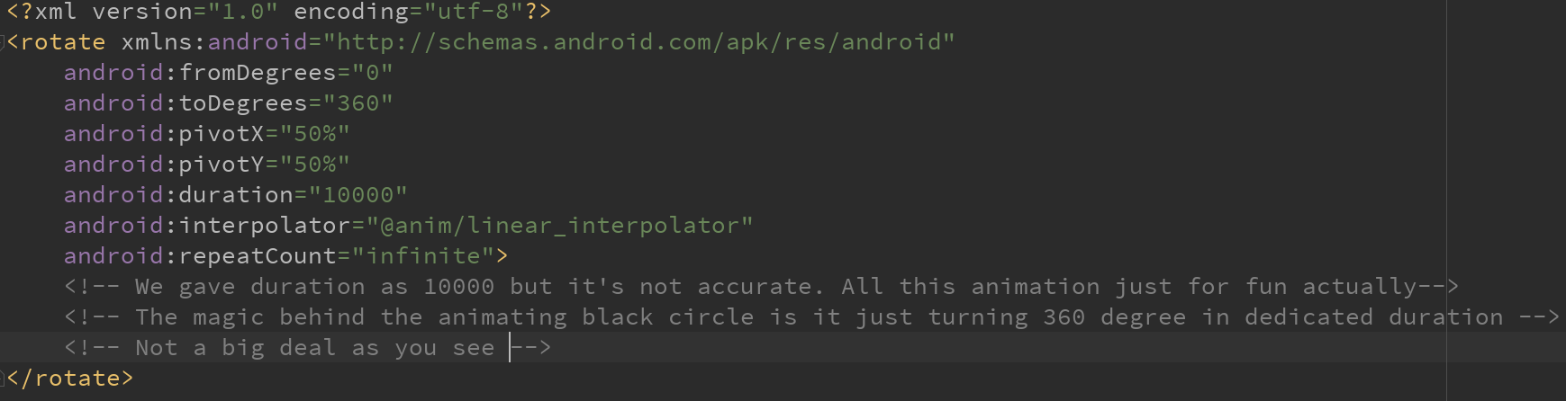
Text: rotation.xml

Slide 32
Designing the UI
With this last touches, we finally finished to create our xml work.
Now we have to start MainActivity.java to make all this xml files work in harmony.

Slide 33
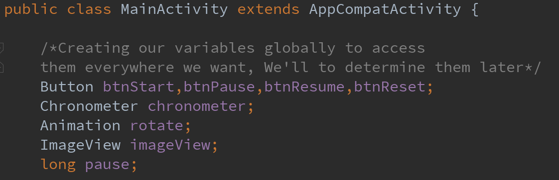
MainActivity.java: Global Variables

Slide 34
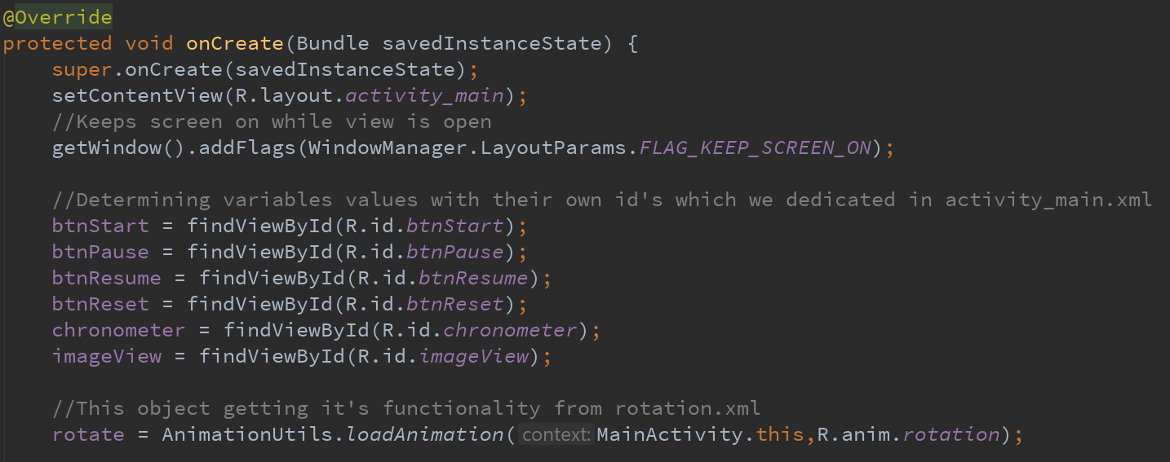
MainActivity.java: Defining the value of the variables

Slide 35
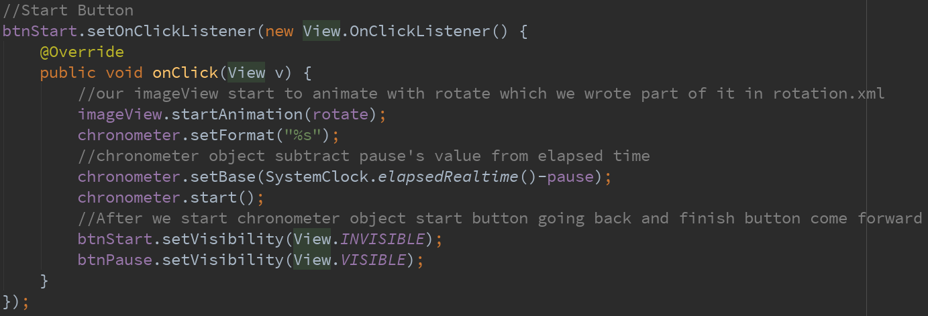
MainActivity.java: Start Button’s onClick event

Slide 36
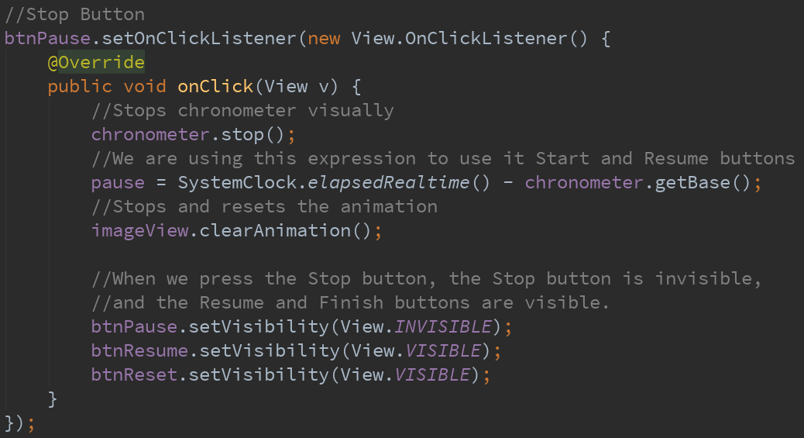
MainActivity.java: Stop/Resume Button’s onClick event

Slide 37
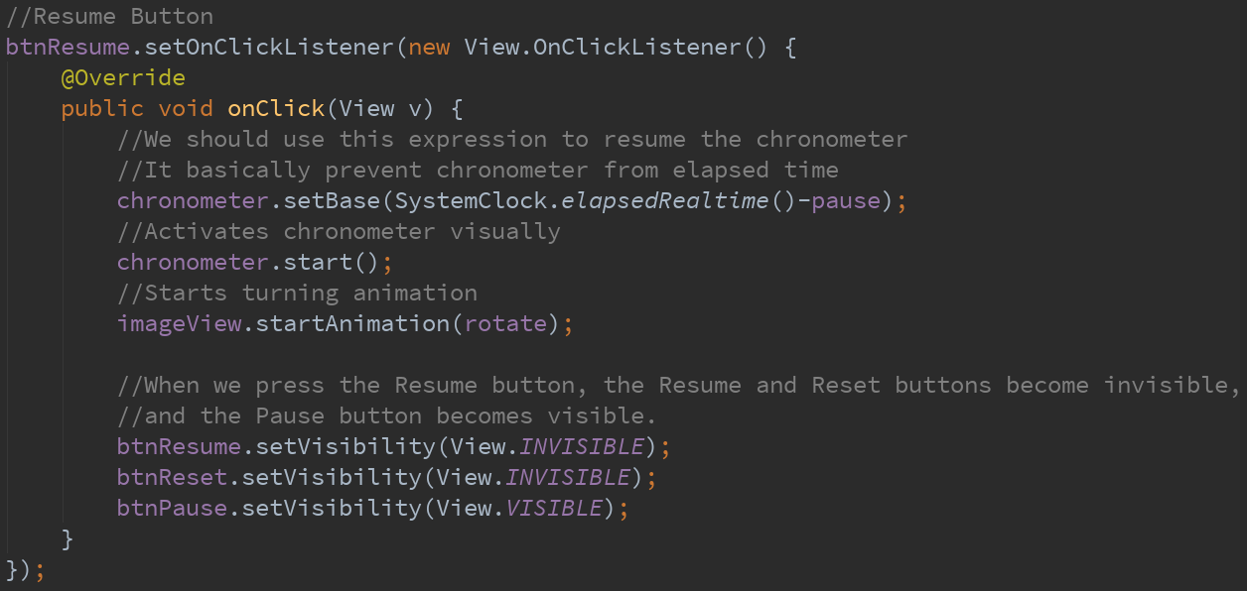
MainActivity.java: Resume Button’s onClick event

Slide 38
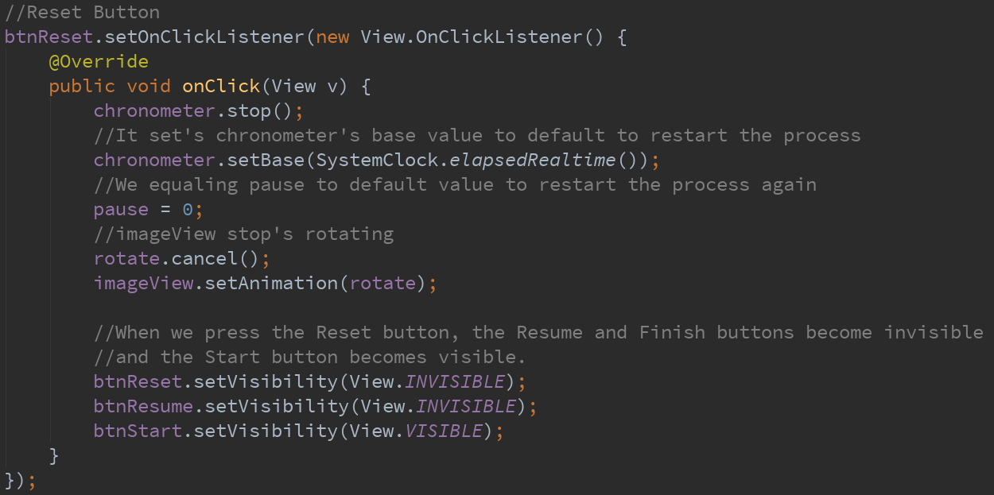
MainActivity.java: Reset Button’s onClick event

Slide 39
Congratulations !
We finally finished the whole application !
Now let’s look our application and see what we made again…

Slide 40
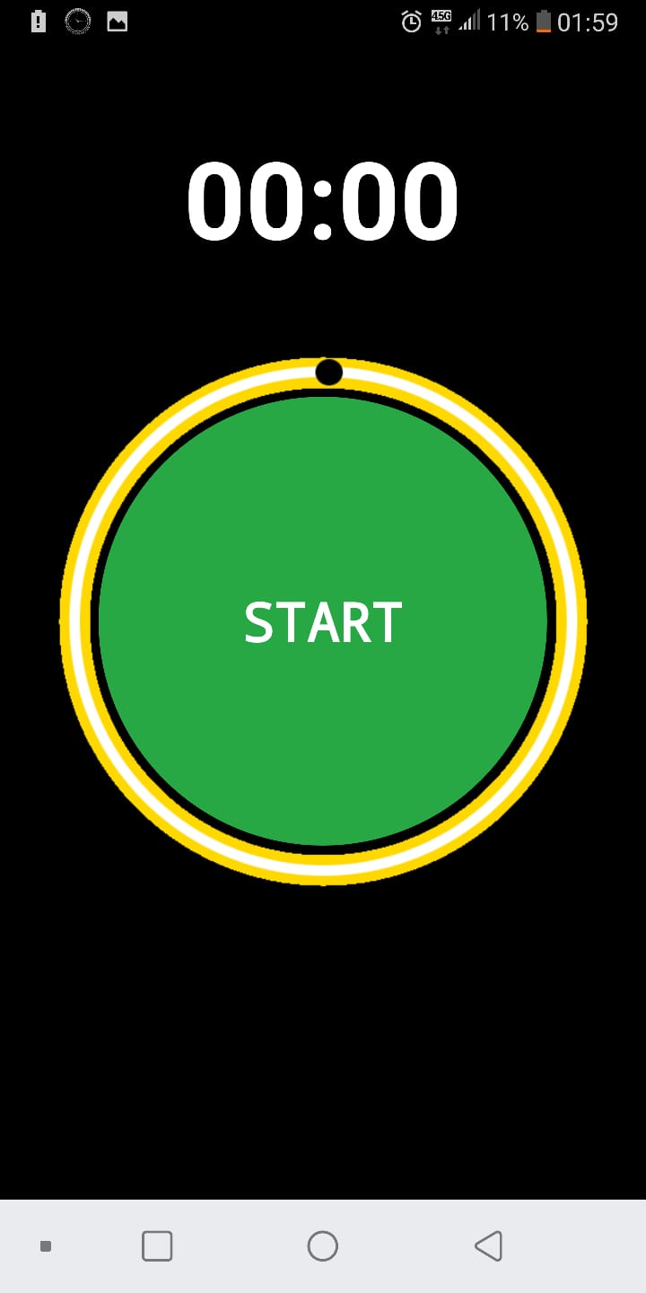
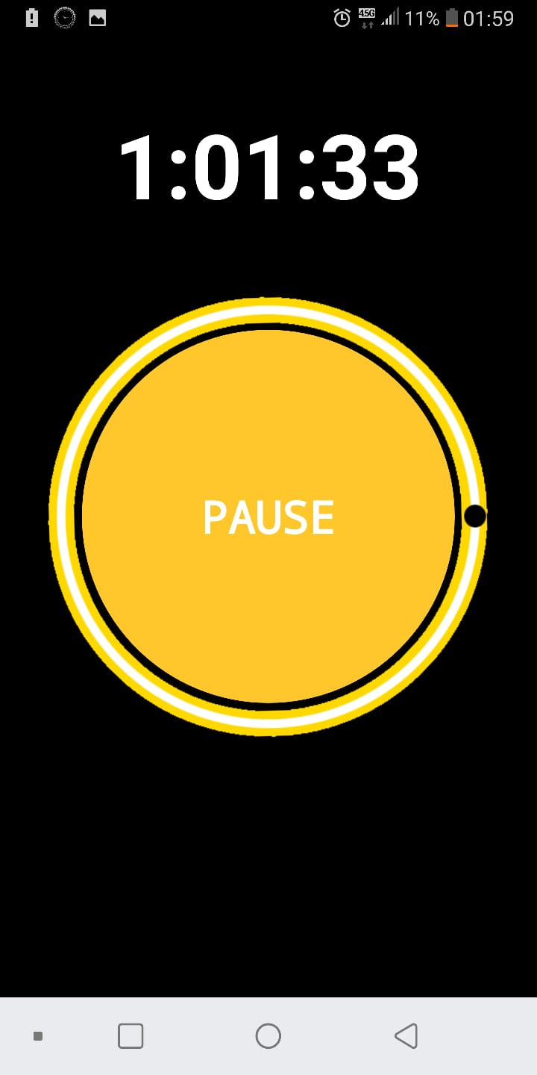
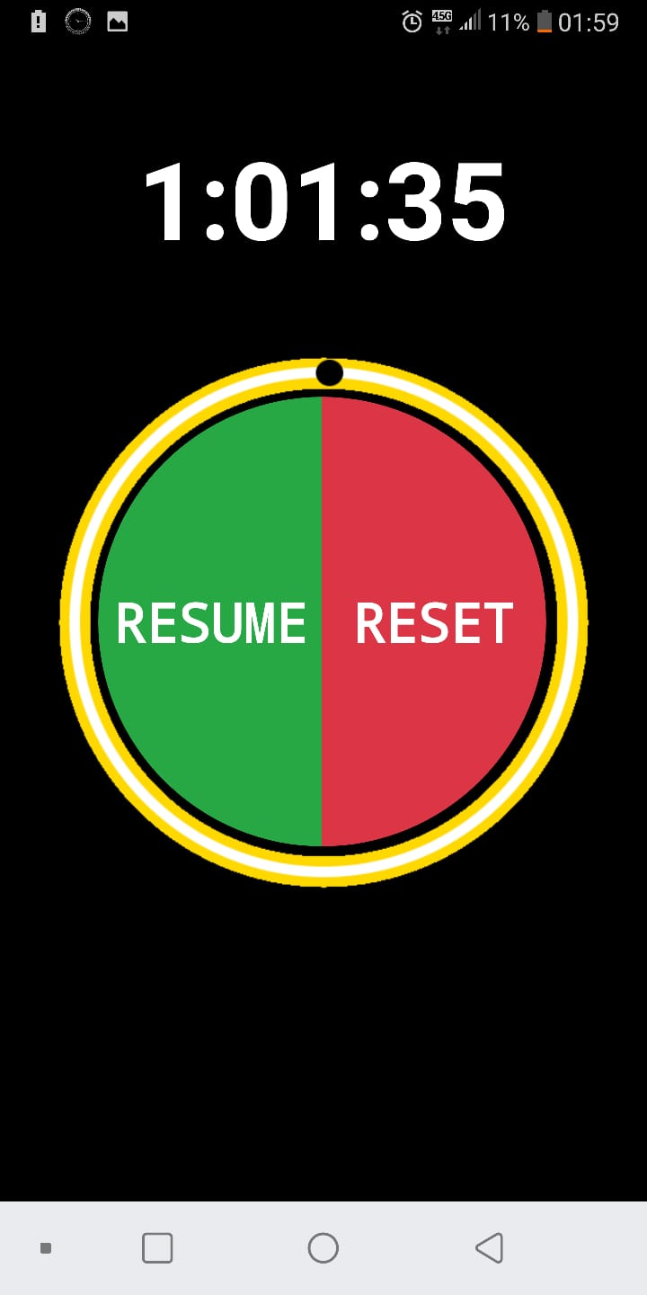
When we run the application we see this;
>
>

Slide 41
To see our achievement after our work, let’s watch it again !

Slide 42
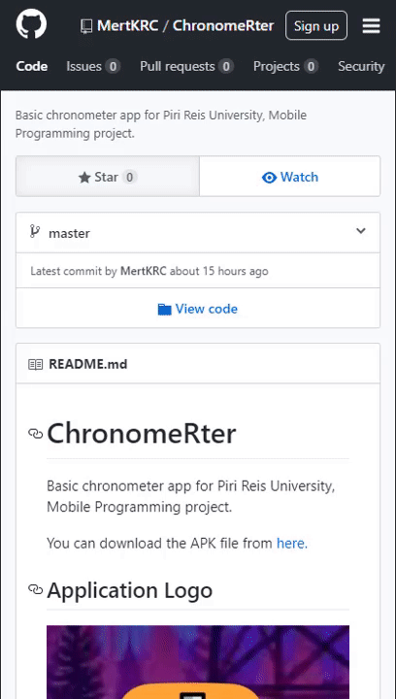
Thank you for watching & listening!
I hope the presentation has brought you something.
To understand this subject even more, you can access project’s source codes from Github in the link below. So you can make your own sandbox.
Github: github.com/MertKRC/ChronomeRter
Mert KARACA

